Slide 1
Creating Accessible Word Documents
A BEST Grant Activity from the Assistive Technology and Accessible Educational Materials Center

Slide 2
AT&AEM Center and the BEST Grant
Assistive Technology and Accessible Educational Materials Center
Promotes accessibility and personalization, creates and disseminates accessible materials, and offers specialized training and technical assistance
Braille Excellence for Students and Teachers Grant
PD and technical assistance dedicated to braille literacy, braille instruction, braille materials, and braille technology

Slide 3
Learning Objectives
Explain the importance of creating accessibly as it applies to accessibility standards and increasing access
Apply understanding of concepts by working through a practice document
Identify common accessibility errors within Word documents and how to remediate them

Slide 4
Today’s Agenda
Overview
Document Properties
Formatting for Text and Images
Alternative Text
Utilizing Styles for Document Structure
Tables
Finalizing the Document
Converting to PDF

Slide 5
Presentation Style
3 hours, 3 breaks
Slide presentation with supplemental materials to follow along
6 chat activities
Please use the raise hand feature to ask questions or place the question in chat

Slide 6
Supplemental Materials
You can access all materials through your email or the AT&AEM Center website.
You will need:
Practice Document for Remediation – Inaccessible
Accessible Word Documents Checklist
Accessible Tables Checklist

Slide 7
Focused on B/VI
Accessible design and development can benefit many people, both those with disabilities and those who don’t identify as disabled. This presentation will focus on B/VI as it is part of the BEST Grant and meant to support educators working with visually impaired students or are transcribing materials into braille

Slide 8
Language and Identity
OCALI understands:
the impact language can have
that people find strength in their identity
PFL and IFL
Notes:
Image taken from https://en.wikipedia.org/wiki/Black_American_Sign_Language

Slide 9
Legal and Ethical Considerations

Slide 10
Chat Activity 1
What does access mean to you?

Slide 11
Background and Overview

Slide 12
Why Create Accessibly?
Compliance - Meet IDEA, Section 508, ADA, and OCR mandates
User Experience – user preferences and user needs

Slide 13
General Legal Considerations
Section 508 of the Rehabilitation Act
Requirements to make ICT and content accessible
Web Content Accessibility Guidelines (WCAG)
Referenced in 508
PDF/UA – ISO 14289
Referenced in WCAG
Subset of ISO 32000 (PDF Standard)

Slide 14
K-12 Legal Considerations
IDEA and NIMAS
“provide specialized formats of print instructional materials to blind and other print disabled persons in a timely manner.”
Marrakesh Treaty
Adopted in 2013 by International World Intellectual Property Organization (WIPO)
Incorporated into U.S. Law in 2018 – eligible person and accessible formats
Section 504 of the Rehabilitation Act
Prohibits discrimination for institutions receiving federal funds

Slide 15
Ethical Considerations
People who use:
Keyboard navigation
Small screens
Dictation software
Screen readers
AT devices
Should have:
Equal ease of access
Access to the same content
Access to information at the same time

Slide 16
Screen Reader User Survey
Survey on Screen Reader Users:
87.6% reported a disability
12.4% reported no disability
Source: WebAim Screen Reader User Survey #8 Results

Slide 17
Disabilities Reported
Disabilities Reported:
Blindness – 76%
Visually Impaired – 18.5%
Cognitive – 3.3%
Deafness/HH – 6%
Motor – 2%
Other – 3.7%
Multiple Disabilities – 15.8%
Deafblind – 4.7%
Source: WebAim Screen Reader User Survey #8 Results

Slide 18
Screen Reader Proficiency
Advanced - 62.2%
Intermediate - 32.4%
Beginner - 5.4%
Source: WebAim Screen Reader User Survey #8 Results

Slide 19
Internet Proficiency
Advanced - 76%
Intermediate - 22.8%
Beginner - 1.2%
Source: WebAim Screen Reader User Survey #8 Results

Slide 20
Finding Information
Navigate through headings – 68.8%
Source: WebAim Screen Reader User Survey #8 Results

Slide 21
Word Issues
Very likely – 9.5%
Somewhat likely – 21.4%
Somewhat unlikely – 27.2%
Very unlikely – 37.4%
I don’t know – 4.6%
Source: WebAim Screen Reader User Survey #8 Results

Slide 22
PDF Issues
Very likely – 36.8%
Somewhat likely – 38.3%
Somewhat unlikely – 12.3%
Very unlikely – 9.4%
I don’t know – 3.2%
Source: WebAim Screen Reader User Survey #8 Results

Slide 23
Four Principles of Accessibility
Perceivable
Operable
Understandable
Robust

Slide 24
Perceivable
Information must be presented in ways that the users can perceive
Examples: Alt Text, Captions, Contrast
Source: Web Content Accessibility Guidelines 2.0

Slide 25
Operable
The interface components and navigation must be able to be used. Examples: Keyboard accessible, timing
Source: Web Content Accessibility Guidelines 2.0

Slide 26
Understandable
Information and navigation is presented in a way that is understandable to the user.
Examples: text is readable, images assist with comprehension
Source: Web Content Accessibility Guidelines 2.0

Slide 27
Robust
Material can be viewed by a wide variety of users and assistive technologies.
Examples: compatibility across browsers and with assistive technologies
Source: Web Content Accessibility Guidelines 2.0

Slide 28
Chat Activity 2
Watch video of OLAC Flyer –
What barriers do you recognize as you listen to the screen reader?

Slide 29
Source Documents

Slide 30
Source Documents Importance
Starting with an accessible source document is best
Remediating the source document is almost always easier
Content developers
Authoring tools
Microsoft Word and PowerPoint
Google Docs and Slides

Slide 31
Getting Started
Gather external resources and check for accessibility
Have a checklist ready for use
Plan ahead for any potential barriers

Slide 32
Chat Activity 3
As a TVI, do you plan on:
creating instructional materials for students
supporting general education teachers in remediating teacher made materials for students
converting materials from publishers?

Slide 33
Microsoft Word

Slide 34
Objectives
Follow the checklist to learn about:
Document Properties
Formatting for Text and Images
Alternative Text
Utilizing Styles for Document Structure
Tables
Finalizing the Document
Converting to PDF

Slide 35
Document Properties
Title
Author
Language
Subject
Keywords

Slide 36
Title, Author, and Language
Title
Should match the file name
Avoid hyphens
Avoid long or unclear titles
Author
Name or organization
Language

Slide 37
Subject and Keywords
Subject
Keywords
Separate multiple keywords or phrases with a comma

Slide 38
Document Properties Practice
Mac:
File – Properties –
Summary
PC:
File – Info – Properties

Slide 39
Formatting Text and Images

Slide 40
Font
Use Sans serif fonts consistently
Arial, Calibri, Helvetica
Use adequate sizing
Title:14-18pt
Headings:12-16pt
Text:12-14pt

Slide 41
Text 1
Use the same font throughout the document
Place emphasis on text by using bold or bold italics
Use borders to create visual effects around text

Slide 42
Text 2
Things to avoid:
Watermarks
Word Art
All caps
Text boxes
Drop Caps
Images of text
Poor color contrast

Slide 43
Hyperlinks
Hyperlink text should be meaningful
Consistent for the same destination
Unique for different destinations
URL can be included as an inactive link

Slide 44
Chat Activity 4
Listen to the screen reader read the urls and the meaningful hyperlink.
What did you notice about the url being read?

Slide 45
Hyperlinks in a List
What Makes a Good Link Text helps explain why hyperlinks are important for ease of access and navigation.

Slide 46
Practice 1
Document Properties
Meaningful Hyperlinks
Text

Slide 47
Non-Text Elements
All non-text elements should have alt text
Multi-layered images have been combined or grouped
Captions are provided above images or figures
Detailed descriptions are provided below images
Images are in line with text

Slide 48
Images
Images should be used to support understanding
Animated and flashing images should be avoided
Alt Text or captions are needed for images

Slide 49
Alternative Text (Alt Text)
Things to consider:
Age and expertise
Context of the image
Be accurate and concise
Explain the function
Repeat text
Captions for complex images
Things to avoid:
Words like ‘picture’ or ‘image’
Repeating a caption
Empty alt text
Color (context)
Analysis
Omitting content

Slide 50
Alternative Text
Limited to 125 characters
Decorative images can be marked as such
Don’t rely on autogenerated alt text

Slide 51
Chat Activity 5
Review the three following images and respond through the chat what you think would be the best alt text

Slide 52
Alt Text Practice 1
Graduation
Several students in graduation attire outside of a school.
Six high school graduates in Columbus, Ohio outside of a high school. The students are wearing caps and gowns with tassels hanging from the caps.
Context: The picture is found on the cover of a state’s guidebook for high school graduation requirements.

Slide 53
Alt Text Practice 2
Trees in a park
Several trees surrounding a dirt path
Trees surrounded by grass and leaves in a park.
Context: The picture is used in a park brochure to promote a walking program for adults.

Slide 54
Alt Text Practice 3
Write your own
Context: The picture is used on a 2nd grade science book introducing students to different plants.

Slide 55
Additional Resources
Image description resource available from the DIAGRAM Center.

Slide 56
Practice 2
Adding Alt Text to Images

Slide 57
Color
Use color to increase understanding or enhancement, but not as a sole means
Alternative methods:
Symbols
Texture
Bold

Slide 58
Color and Texture Example

Slide 59
Contrast
Use contrasting colors, such as light text on a dark background or dark text on a light background
Avoid color-blind combinations

Slide 60
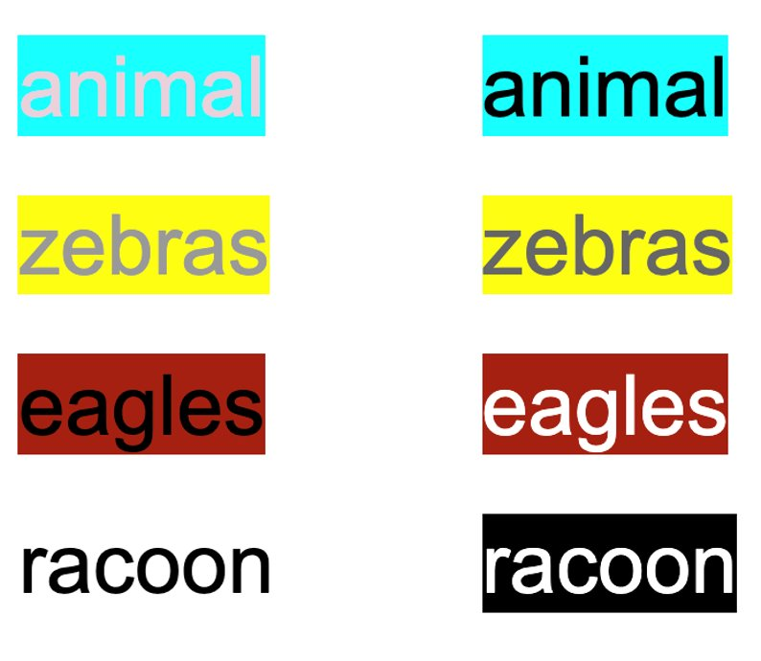
Contrast Example

Slide 61
Contrast Example 2

Slide 62
Color Contrast Tools
WebAIM: Color Contrast Checker
Colour Contrast Analyzer
Color Contrast Analyzer

Slide 63
Colorsafe Tool
Use the Colorsafe Tool to practice exploring background colors and text colors that have adequate contrast
You can enter the HEX Color Codes into Word

Slide 64
Practice 3
Color Contrast

Slide 65
Styles and Document Structure

Slide 66
Headings and Body Text
Styles is a formatting tool that:
Provides visual structure
Ensures easy navigation
Maintains structure when converted to PDF or HTML

Slide 67
Heading Structure
Think of notetaking/outline structure when using Headings:
Title (Heading 1)
Section 1 (Heading 2)
Topic 1 (Heading 3)
Sub-topic (Heading 4)
Topic 2 (Heading 3)
Section 2 (Heading 2)
Topic 1 (Heading 3)
Section 3 (Heading 2)
Topic 1 (Heading 3)
Sub-topic 1 (Heading 4)
Sub-topic 2 (Heading 4)
Topic 2 (Heading 3)

Slide 68
Line Spacing
Use line spacing options within Word to create spaces between lines or sections
Do not use the enter or space key to create a visual break

Slide 69
Lists and Columns
Lists
Bullet library, numbering library, or new list style
Numbering style for ordered lists
Bullet style for unordered lists
Columns
Columns tool is used to create columns
Left aligned
No more than 3 columns

Slide 70
Practice 4
Headings, Line Spacing, and Lists

Slide 71
Document Elements

Slide 72
Elements
Page numbers
Text is left justified
Headers and Footers
Logo, page numbers, copyright messages, or running headers
Breaks are created as Section Breaks

Slide 73
Content
Language, Structure, and Flesch Reading Score

Slide 74
Language and Structure
Type out acronyms on the first reference in the document
Avoid excessive acronyms or jargon
Avoid unclear language:
This, that, those, there

Slide 75
Flesch Reading Score
Readability Statistics
Mac - Word – Preferences – Spelling and Grammar – Show Readability Statistics
PC - File – Options – Proofing – Readability Statistics
Run Editor to check the document

Slide 76
Practice 5
Flesch Reading Score

Slide 77
Tables
Creation and Structure

Slide 78
Table Creation
Use tables for data
Insert tables using the Insert Table tool

Slide 79
Header Row
Header Row is selected in the Table Design tab

Slide 80
Repeat Header Rows
Repeat Header Rows is selected in the Table Layout tab

Slide 81
Table Structure
Things to avoid:
Merging or splitting cells
Complex tables
Using Headings Styles within the Style Pane
Blank cells within the table
Rows breaking across pages

Slide 82
Table Bookmarks
Bookmarks should be set for each table
Insert – Bookmark – Bookmark Name
Title
RowTitle
ColumnTitle

Slide 83
Table Title
Table Layout Tab – Properties – Alt Text

Slide 84
Table Captions
Reference Tab – Insert Caption

Slide 85
Practice 6
Tables

Slide 86
Finalizing the Document
Navigation Pane, Accessibility Check, Table of Contents

Slide 87
Spelling Errors and Comments
Address all spelling errors
Remove comments and track changes from source document

Slide 88
Non-printing Characters
Check for non-printing characters
Home – ¶

Slide 89
Table of Contents
Provide an overview of the content
Increase ease of navigation
References – Table of Contents – Classic or Simple

Slide 90
Check Accessibility
The Check Accessibility tool will display errors, warnings, and tips.
Review – Check Accessibility

Slide 91
Errors
Cannot be read or understood
Images missing alt text
Tables without column or row headers
Styles and Headings were not used to organize content

Slide 92
Warnings
Difficult
to understand
Hyperlinks are not meaningful
Headings are too long
Non-text elements are not ‘in line with text’
Excessive blank spaces

Slide 93
Tips
Content could be presented in a different way
Reading order is not logical
Watermarks are present

Slide 94
Final Check
Update Document Properties
Review Navigation Pane
Check Accessibility

Slide 95
Practice 7
Table of Contents, Non-printing Characters, Accessibility Review

Slide 96
Final Chat Activity
Chat the three top things you learned today

Slide 97
You Made It!
Thank you so much for spending your morning with me!
If you’d like to access materials from this portion of today’s webinar, they will be posted on the AT&AEM Documents and Handouts webpage.
You can also find BEST Professional Development Activities on our webpage!

Slide 98
Rachel Schultz rachel_schultz@ocali.org

