Slide 1
OCALI AT&AEM Center and NIMAC
Large Print Templates and Macros for Microsoft Word
Part 2: Applying Tools and Styles
November 12, 2025

Slide 2
Webinar Communication
Use Zoom Chat to respond to presenter prompts, communicate with other attendees, and share resources.
Use the React button to raise your hand and ask clarifying questions as we go. If we have time at the end, we will answer any remaining questions. Bring additional questions to next week’s office hours!

Slide 3
Webinar Facilitators
Katie Robinson
AEM Production Specialist, AT&AEM Center OCALI
Liz Schaller
NIMAC Manager
Notes:
Rob

Slide 4
The people behind the screen
Katie Robinson katie_robinson@ocali.org
AT&AEM Production Specialist AT&AEM Center at OCALI
Certified Literary Braille Transcriber; test and use the large print templates and macros; low vision large print and braille user
Jerry Whittaker jerry_whittaker@ocali.org
Technical Assistance Consultant AT&AEM Center at OCALI
SLP, M.A. in Audiology; Duxbury, scanning and OCR for braille and large print, tactile graphics; programmer of the large print templates and macros

Slide 5
This meeting is being recorded and will be posted on OCALI’s website for educational purposes.

Slide 6
About OCALI
Vision - Why We Do What We Do
People with disabilities have the opportunity to live their best lives.
Mission - What We Do
OCALI inspires change and promotes access to opportunities for people with disabilities.
Action - How We Do What We Do
OCALI informs public policy and develops and deploys practices grounded in linking research to real life.

Slide 7

About the AT&AEM Center
The AT & AEM Center is a centralized, responsive resource center that empowers individuals with disabilities by providing accessible educational materials, access to assistive technologies and highly specialized technical assistance and professional development support.
https://ataem.org
Notes:
**Ask question after this slide of who is here** parent, family, people with disability, educator, therapist, administrator, parapro or direct service provider

Slide 8
About Language
There is a language consideration you may notice. Person-first language emphasizes the person before the identity or disability, such as person who is deaf or a child with autism. ​
Identity-first language puts the identity or disability first in the description, as in Deaf person or autistic person, recognizing the culture or community. ​
In this presentation you may notice the use of both person-first and identity-first language to ensure that all people have their preferences respected and represented.

Slide 9

OCALI Centers

Slide 10
Session Objectives
Participants will describe the file cleanup sequence used to address common formatting variances.
Participants will use macros to identify, tag, and apply the correct style for large print reference page numbers.
Participants will recognize and apply various proprietary VistaType large print styles using the Styles pane in Microsoft Word.

Slide 11
What is the NIMAC?
The National Instructional Materials Access Center (NIMAC) was created by IDEA 2004 to facilitate access to instructional materials for students with IEPs who are blind or low vision or otherwise cannot utilize regular print books.
The NIMAC is a “one-stop” repository for States and districts to locate and download digital files in the NIMAS format for use in creating accessible formats like braille, large print, digital audio, and digital text formats such as EPUB or DAISY.
The Authorized Users in each state (like the folks at OCALI in Ohio!) can download and assign NIMAS files for accessible format production.

Slide 12
What is NIMAS?
NIMAS is an XML-based file format that is not student-ready. The file must be converted before it can be given to a student.
The zipped file set includes the following:
  XML file with the tagged text of the book.
  An images folders with every image, including math expressions.
  A PDF with the title and copyright pages of the book.
  An OPF with the file metadata.

Slide 13
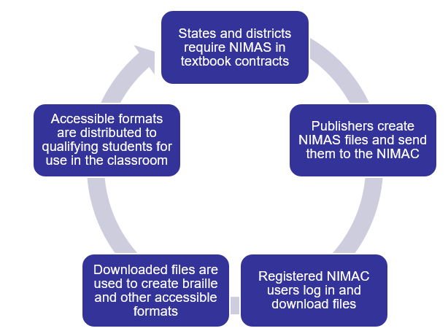
How the NIMAC Serves Students

Slide 14
Becoming a NIMAC AMP
If you work in a school or district, you are welcome to register for a free Accessible Media Producer account with the NIMAC!
An Authorized User in your state will need to assign you any NIMAS files you need.
If you are not already connected with your Authorized Users, we can help!
Please reach out to us at nimac@aph.org with any questions, or for more information about registering as an AMP!

Slide 15
Covered in session one
What is a template?
What are Visual Basic for Applications (VBA) Macros?
The capabilities and limitations of the large print templates and macros.
Downloading and converting a NIMAS file to word.
Downloading and installing the large print templates and macros.
  https://tinyurl.com/mr327kzu

Slide 16
Wait, there’s a braille macros tab?
Can be run independently on any document which is not intended for large print or braille production
  Does not have any effect on SWIFT or BANA braille templates
User guide for the braille macros is located in the user guide folder in the download package

Slide 17
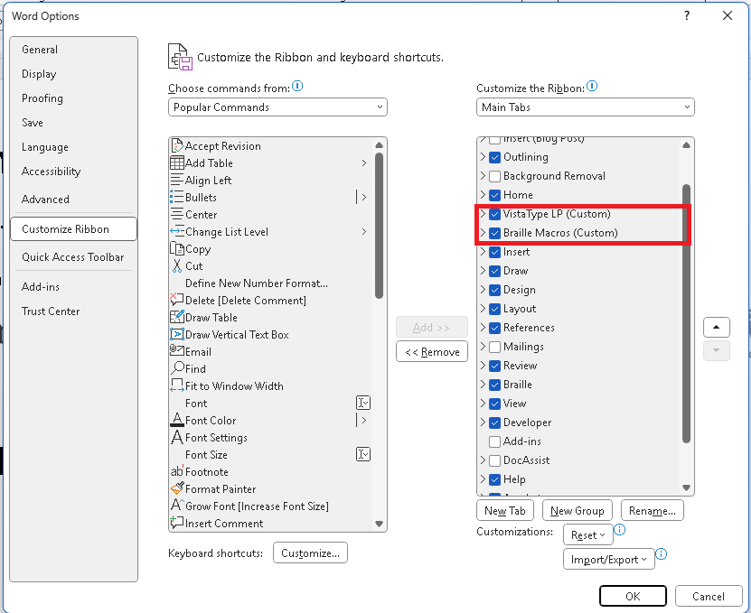
What if the VistaType LP tab is missing from the ribbon?
Open the file menu > options and select customize ribbon

Slide 18
The File Cleanup Sequence
Automatically runs when you attach the large print template to a document
Can be run on a document you have not attached a large print template to (i.e. a document meant for braille production)
Cleans up some known formatting issues from NIMAS files and files OCR’d by Abbyy Fine Reader

Slide 19
How the File Cleanup Sequence Works
Removes spaces before and after punctuation marks.
Removes multiple spaces and replaces with a single space.
Replaces multiple hyphens with a single hyphen; removes spaces before and after hyphens.
Replaces multiple en (–) dashes with a single en dash; removes spaces before and after en dashes.
Replaces multiple em (—) dashes with a single em dash; removes spaces before and after em dashes.

Slide 20
The File Cleanup Sequence continued
Changes italics to non-italic dashed underline style
Replaces variations of normal styles with the large print normal style.
Removes text boxes and frames while preserving content.
Finds each $pg reference tag and ensures that it is at the beginning of a paragraph and is turned red (used in tagging print reference page numbers)

Slide 21
The File Cleanup Sequence - page 3
Replaces small caps with all caps.
Removes tabs and spaces before and after paragraph marks.
Resizes pictures that are too big for the page.

Slide 22
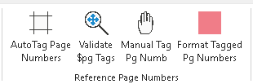
Print reference page numbers
This set of macros is used to find, validate and add the large print reference page number style to documents that have a print reference page number (designed with NIMAS files in mind)

Slide 23
Order of macros to tag and format reference page numbers
In order:
  #1 Auto tag page numbers
  #2 Validate $pg Tags
  #3 Manual tag page numbers that were missed
  #4 Format tagged page numbers
    Uses find and replace to search for page numbers with $pg and replaces that tag with the large print reference page style

Slide 24
Auto tag page numbers
This macro searches the document to try to locate what it thinks could be reference page numbers
When the macro finds what it believes to be a reference page number it adds a temporary tag in front of the number “$pg” so that the tagged items are easy to see visually or find via search
Examples: $pg17, $pgiv

Slide 25
Validate $pg tags
After running the auto tag page numbers macro (adds a tag $pg in front of every potential page number) you need to validate each page number.
The macro does its best but does miss page numbers or incorrectly tag things that are not page numbers

Slide 26
Manual tag page numbers
This macro is used to manually insert a $pg tag in front of a page number that the auto tag search did not find.
Use this button at any time before running the format tagged pg numbers macro
  If you use the manual tag pg number macro after running the format tagged pg numbers macro, you must re-run the format tagged pg numbers macro

Slide 27
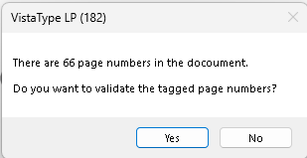
#1 Auto tag page numbers
The macro runs in background after the button is clicked, can take anywhere from 10-60 seconds
When finished a dialog pops up indicating how many potential page numbers it found and asks if you want to validate them.

Slide 28
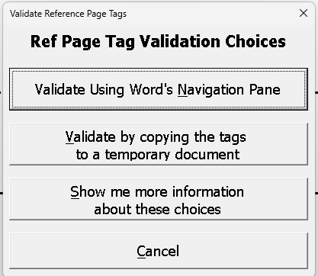
#2 Validate $pg tags
Two validation options
  Using Word's Navigation Pane (better for shorter documents)
  Copy tags to a temporary document (better for larger documents)
A button that will show more information about the two choices

Slide 29
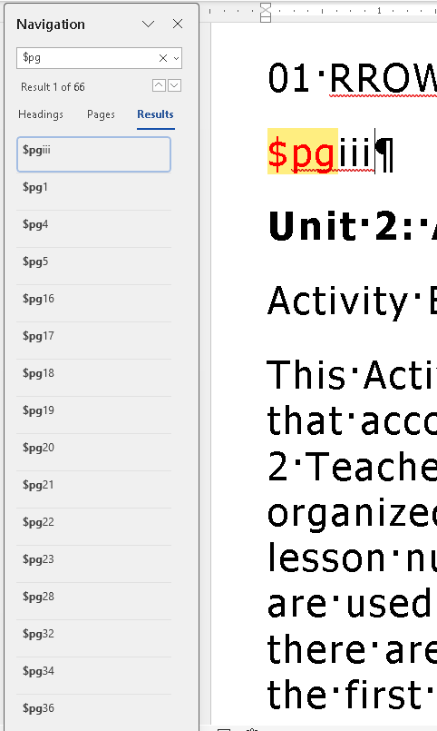
Validate using Word's Navigation Pane
Uses the word find and replace pane to display every instance of $pg that is now attached to every identified potential page number

Slide 30
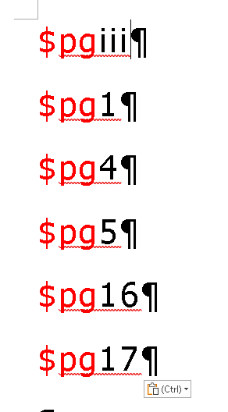
Validate by copying tags to a temporary document
Copies all the potential print page numbers into a new blank word document.

Slide 31
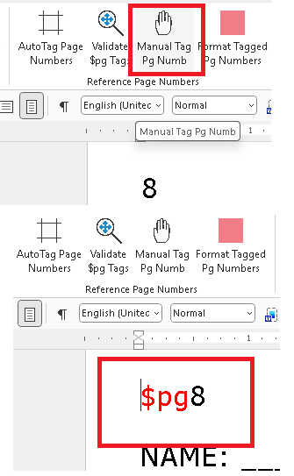
#3 Manually tagging page numbers
Scroll through your document to find any print page number the macro missed
Put the curser right in front of the number and select the Manual Tag Pg Number button, it will manually insert $pg in front of the page number

Slide 32
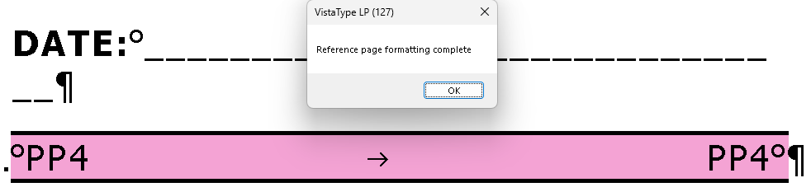
#4 Format tagged pg numbers
After you have validated all the tagged page numbers
  Each page number is in its own paragraph
  Each page number has a $pg in front of the number, you run the format tagged page numbers macro

Slide 33
The large print styles
Heading levels 1-5, each a different color and size
Print reference page numbers
List styles 1-5
Text color styles of blue, green, orange, red and violet
Box color styles of black, blue, orange, red and violet
  I use blue box style to indicate transcriber notes in large print
  I use red box style to indicate print photo captions

Slide 34
The large print styles continued
Word highlight color styles of aqua, black, blue, green, pink, tan and yellow
Paragraph highlight color styles of aqua, black, blue, green, tan and yellow
Table of contents styles levels 1-5
  Can have TOC style with or without dotted lead lines
  Can have alternating color bars as part of TOC style

Slide 35
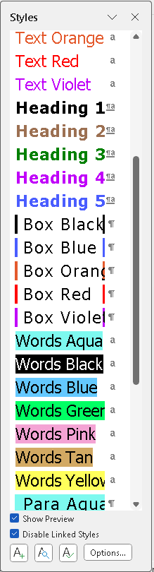
Large print styles shown in the styles pane
When the large print template is attached, the large print styles will show in the styles pane
  Click the “show preview” button at the bottom to see what the style will look like

Slide 36
Questions?

Slide 37
Contact, Connect, & Stay Informed
https://www.linkedin.com/company/american-printing-house-for-the-blind/
OCALI AT&AEM Center
NIMAC
ataem.org
ataem_info@ocali.org
614.410.1042 (voice)
AT&AEM Center on LinkedIn
@ataem_ocali
nimac.us
nimac@aph.org
502-899-2230
APH on LinkedIn

Slide 38
Thank You!
Please complete the survey!

